Slide 1
Project Proposal Presentation
BLG 506E – COMPUTER VISION
BURAK BOZDAĞ - 504211552

Slide 2
Table of Contents
About the Project
Motivation
Project Goals and Impacts
Project Schedule
Conclusion

Slide 3
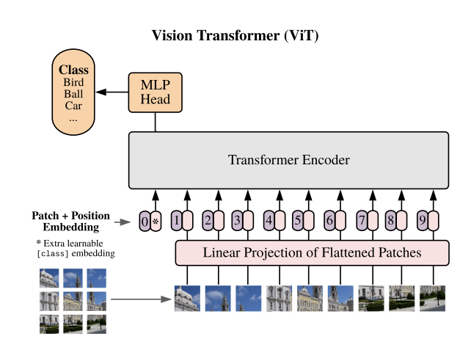
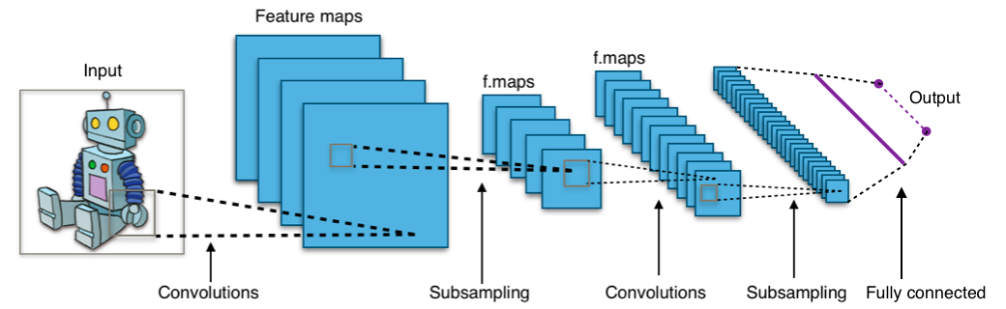
About the Project
Classifying Chest X-Ray Images Using CNN and Transformer Based Architectures
Comparing CNN and transformer models for classifying patients as normal or infected
CNN

Slide 4
Motivation
CNN is a standard in CV
Transformer based models in NLP
A. Dosovitsky et al., "An Image is Worth 16x16 Words: Transformers for Image Recognition at Scale", 2021. Available: https://openreview.net/forum?id=YicbFdNTTy.
Transformers applied directly to image patches and pre-trained on large datasets work really well on image classification.
Find out which is better for classifying x-ray images

Slide 5
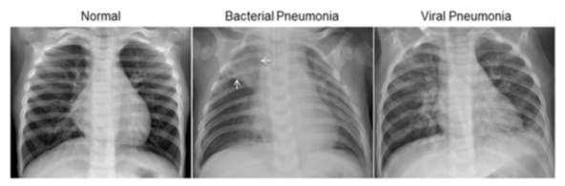
Project Goals and Impacts
Classifying chest x-ray images as normal or infected
Comparing CNN and ViT models

Slide 6
Project Schedule
Initial Planning & Project Proposal
Background research and planning
Preparing Model
Evaluate datasets and models
Machine Learning Model
Pre-processing
Parameter tuning
Training-testing
Final Works
Results
Report and presentation

Slide 7
Conclusion
Classifying Chest X-Ray Images Using CNN and Transformer Based Architectures
Classifying chest x-ray images
Comparing CNN and ViT
Pre-processing
Parameter optimization

